Slide 1
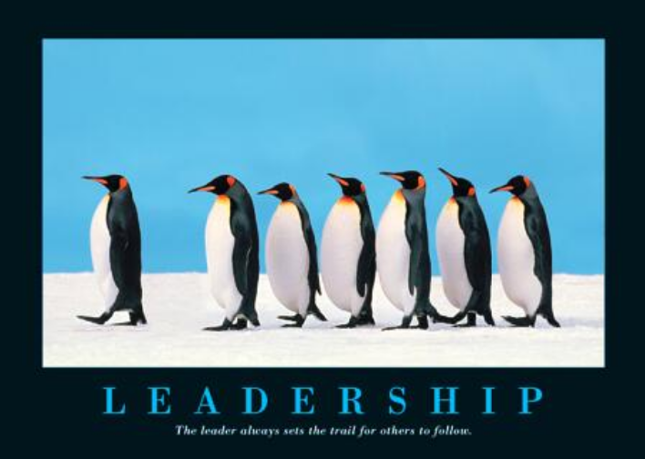
Leadership Lecture Slides: Dr. Hoch

Slide 2
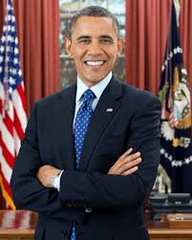
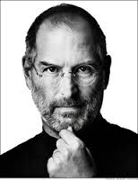
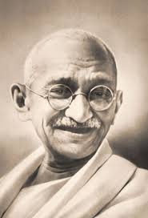
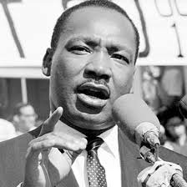
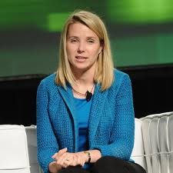
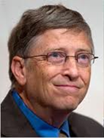
Leadership
Learning Goals
What is leadership?
What are traits of effective leaders?
What are behaviors of effective leaders?
How does leadership style depend on context?
Types of leadership: transformational, transactional, servant, and authentic leadership
Notes:
Faces of leadership: http://www.youtube.com/watch?v=jwxPzWHWq1M

Slide 3

Before We Begin…
What famous leaders can you think of?
What makes them so effective?
What attributes do famous leaders have?
How do they behave?
The Dancer – Leadership lessons: http://www.youtube.com/watch?v=fW8amMCVAJQ

Slide 4
Examples of Leaders from Various Fields
Science
  Albert Einstein
Spiritual
  Daili Lama
  Mother Teresa
Business/Corporate
  Steve Jobs
  Bill Gates
  Marissa Mayer
  Renee James (Intel President)
Sports
  Muhammud Ali
  Michael Jordan
  Tiger Woods
Adventure
  Neil Armstrong
  Amelia Earhardt
  Wright Brothers
Political
  Winston Churchill
  Ben Franklin
  Thomas Jefferson
  John Kennedy
  Nelson Mandella
  Martin Luther King

Slide 5
Evolution of Leadership Theories
Trait theories
Skills vs. Behavioral theories
Contingency theories
Great people are leaders
Leadership depends on the setting
Leadership can be trained

Slide 6
Leadership is the act of influencing others to work toward a goal
Informal leaders are without a formal position
Influencing others through personal forms of power
Formal leaders hold a position of authority
Utilize their position and their personal power to influence others

Slide 7
Functions of Management and Leadership (Kotter, 1990)
Leadership and Management
Management – Produces Order and Consistency | Leadership – Produces Change and Movement
Planning and Budgeting Establish agendas Set timetables Allocate resources | Establish Direction Create a vision Clarify the big picture Set strategies
Organizing and Staffing Provide structure Make job placements Establish rules and procedures | Aligning People Communicate goals Seek commitment Build teams and coalitions
Controlling and Problem Solving Develop incentives Generate creative solutions Take corrective action | Motivating and Inspiring Inspire and energize Empower subordinates Satisfy unmet needs
http://www.youtube.com/watch?v=lnaOz1TWENQ

Slide 8
Trait Approaches to Leadership
Intelligence
Extraversion
Conscientious
Self-esteem
Open to Experience
Integrity
Notes:
Other trait classifications have:
Intelligence – Verbal, perceptual, and reasoning capabilities
Self-Confidence – Certainty about one’s competencies and skills
Determination – Desire to get the job done (i.e., initiative, persistence, drive)
Integrity – The quality of honesty and trustworthiness
Sociability – Leader’s inclination to seek out pleasant social relationships

Slide 9
What Do Leaders Do?
Behavioral Approaches to Leadership
Task oriented leader behaviors involve structuring the roles of subordinates, providing them with instructions and behaving in ways that will increase the performance of the group
*Task oriented behaviors are directives given to employees to get things done and to ensure that organizational goals are met
People oriented leader behaviors include showing concern for employee feelings and treating employees with respect
*People oriented leaders genuinely care about the well being of their employees and they demonstrate their concern in their actions and decisions
Notes:
Pre-class assessment

Slide 10
Leadership Behaviors
Kurt Lewin
(University of Iowa)
1) Autocratic
2) Democratic
3) Laissez-faire
1) Initiation
2) Consideration
1) Production-oriented
2) Employee-oriented
1) Concern for production
2) Concern for people
Ohio State
University of Michigan
Managerial Grid

Slide 11
Contingency Approaches to Leadership
The Role of Context
Fiedler’s Contingency Theory
Situational Leadership: Hersey & Blanchard
Vroom and Yetton- Leadership Decisions
Notes:
Hersey and Blanchard: Takes into consideration the development level of the follower.

Slide 12
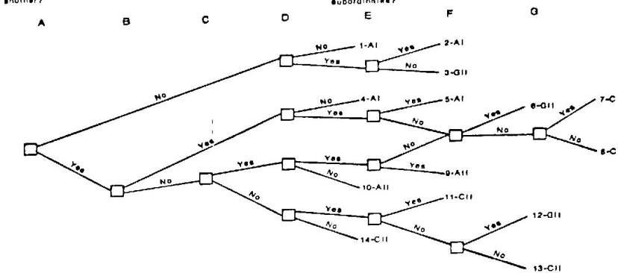
Vroom and Yetton- Leadership Decisions
The decision tree approach is a guide leaders can use to decide how participative they should be given decision environment characteristics

Slide 13
Leader Decision Making
Authoritarian decision making
Leader makes the decision
Democratic decision making
Employees participate in the making of the decision
Laissez-faire decision making
Employees make decision and leader provides minimum guidance

Slide 14
Telling/directing *Employees are committed but need constant direction
Selling/coaching *Leaders encourage and collaborate to gain results
Participating/supporting *Leaders provide guidance and employees make decisions
Delegating *Leaders assign and make employees responsible

Slide 15
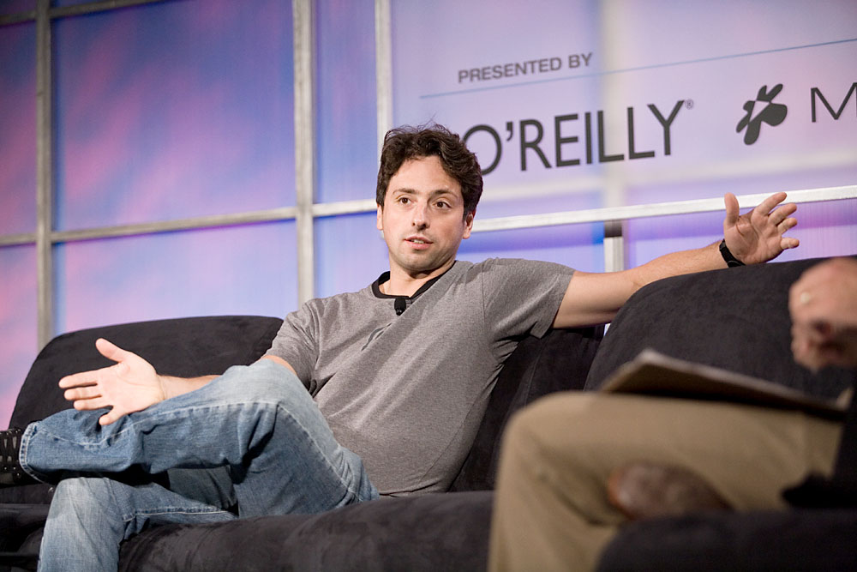
Democratic Decision Making Style
Sergey Brin, Google co-founder, is known for his democratic decision making style
Steve Jobs talks
about
managing
teams: https://www.youtube.com/watch?v=f60dheI4ARg
Source: http://commons.wikimedia.org/wiki/Image:Sergey_Brin,_Web_2.0_Conference.jpg
Notes:
Hersey and Blanchard: Takes into consideration the development level of the follower.
Steve Jobs: Speaks about highly developed and skilled “followers”
This is different than a, e.g., assembly line situation.

Slide 16
Leader-Member Exchange (LMX) Theory
High quality LMX relationships have mutual respect between the leader and the followers
Low quality LMX relationships portray lower levels of trust and respect between leaders and followers
Notes:
Development in stages
Develops in the long run, over time
Creates ingroups and outgroups
Self-select and select in and out
Bi-directional, goes from both directions.
Survey pre-class.

Slide 17
<<<<CHARISMA>>>>
Mandela: Inspiring leadership by Example:
https://www.youtube.com/watch?v=TQhns5AwAkA
Transactional Leadership
*Employees demonstrate the right behaviors because the leader provides resources in exchange
Transformational Leadership
*Employees focus on company’s well being rather than individual pursuits
Notes:
Transactional leadership: Focus on a fairly straightforward exchange between the leader and the followers.
Transformational leadership is inspiring, breaks with common beliefs, going “above and beyond”.
In organizations: “transforms” followers to that followers replace their own needs with the goals of the organization; Trust; Extra Effort.

Slide 18
Transformational leaders lead employees by aligning employee goals with the leader’s goals
Transformational Leaders
Charisma: Idealized Influence, Leading by Example
Inspirational motivation
Intellectual stimulation
Individualized consideration

Slide 19
Authentic Leadership
Leaders are self aware
Not afraid to act the
way they are
Possess high levels of
personal integrity
Leaders are introspective
Understand where they
are coming from
Retain a thorough understanding of their own values and priorities
Notes:
Specifically, AL comprises the four behaviors of:
1) balanced or “unbiased” processing of information,
2) moral development,
3) relationship transparency, and
4) self-awareness.
(e.g., Walumbwa et al., 2008)

Slide 20
Servant Leadership
Defines the leader’s role as serving the needs of others
The primary mission of the leader is to develop employees and help them reach their goals
Servant leaders put their employees first, understand their personal needs and desires, empower them, and help them develop in their careers

Slide 21
Ethical Leadership
Ethical leaders seek to do the right thing and conduct their lives and leadership roles in an ethical manner (Brown & Treviño, 2006).
Ethical leadership: “the demonstration of normatively appropriate conduct through personal actions and interpersonal relationships, and the promotion of such conduct to followers through two-way communication, reinforcement, and decision-making” (Brown et al, 2005: 120).
trait (i.e., the moral person)
behavior (i.e., the moral manager)

